Slide 1
BIKE SHARING DEMAND ANALYSIS
PROJECT FROM - NEXTHIKES IT SOLUTIONS
By-
Shivani Kiran

Slide 2
Introduction & Project Objective
• Bike-sharing demand is explored against time, weather, weekdays and holidays.
• The workbook organizes rental data and supporting calendar/weather fields for analysis.
• Excel outputs include an extract sheet, dashboard, pivot tables/charts, correlation charts, heatmap, anomaly analysis and forecasting.
• The project goal is to turn raw data into understandable summaries that can support planning.
2

Slide 3
How I Completed the Project — Step by Step
Loaded the provided rental and weather datasets into Excel sheets.
Organized fields in EXTRACT DATA SHEET and used formulas to derive month, weekday and day-type labels.
Summarized demand with pivot tables and charts using grouping fields such as month, hour, weekday, holiday and weather.
Compared numerical fields with correlation charts and values in the heatmap matrix.
Applied the IQR method to total rentals, calculated quartiles and boundaries, and separated normal/anomaly series.
Used the Forecast Sheet output to show predicted rentals with confidence bounds.
Collected key visual summaries in the dashboard for quick review.
16

Slide 4
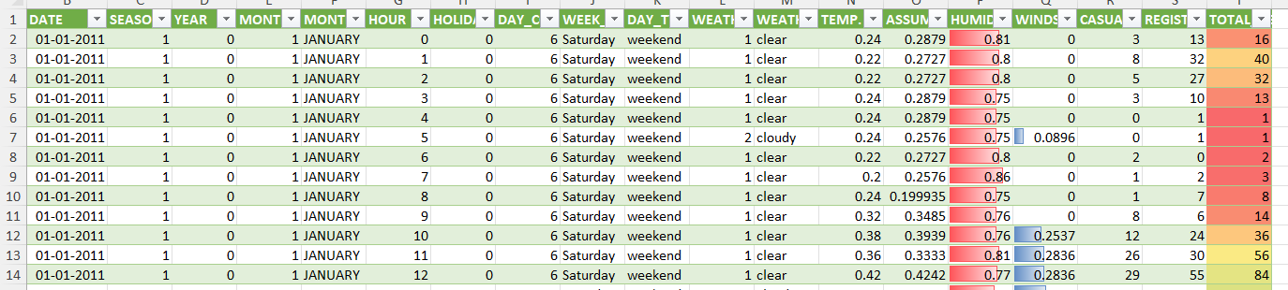
Extract Data Sheet
Preprocessing raw data set 1 and 2 and merging them
Appended data set 3 with preprocessing appended data sheet 3
Preparation of final data sheet for analysis of project
What was extracted -
Calendar/time fields include date, season, year, month, hour, holiday and weekday.
Weather fields describe conditions; rental measures include casual, registered and total rentals.
3

Slide 5
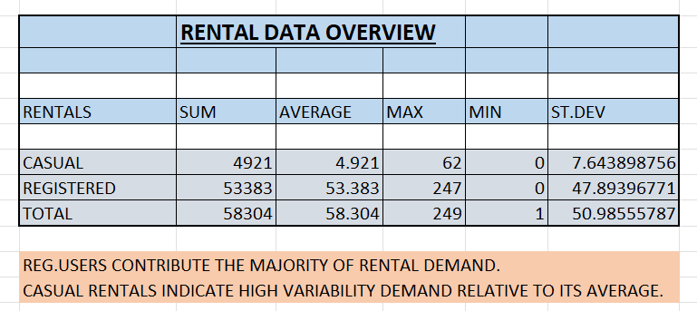
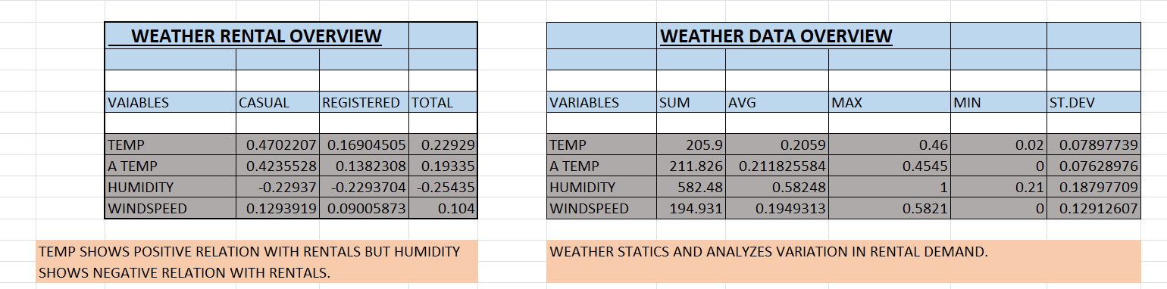
Statistical Overview
Total Rentals – 58,304
Average Casuals – 4,921
Average Registered – 53,383
Total records – 1000
Total days - 45

Slide 6
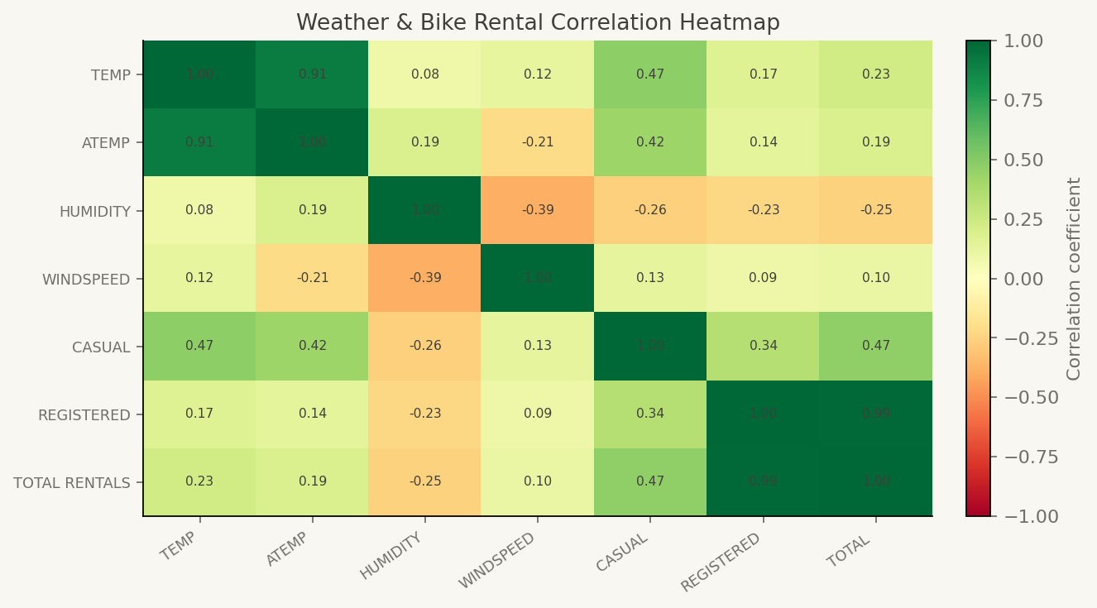
Heatmap Correlation Sheet
• Step 1: selected numeric columns (temperature, apparent temperature, humidity, wind speed and rental counts).
• Step 2: calculated pairwise correlations using CORREL().
• Step 3: arranged coefficients in a matrix and applied colour formatting.
• Green tones indicate positive association; red tones indicate negative association; values near zero indicate weak linear association.
11

Slide 7
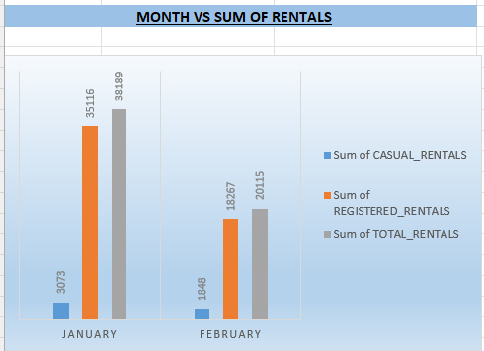
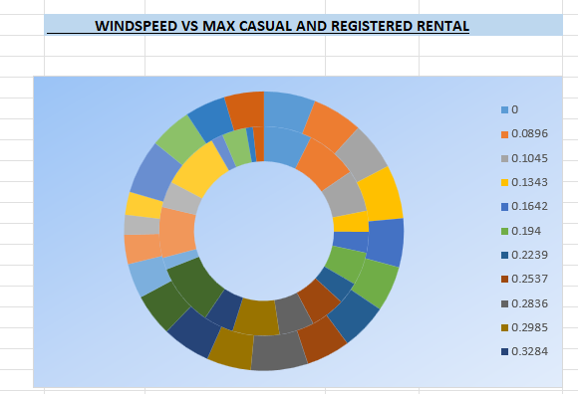
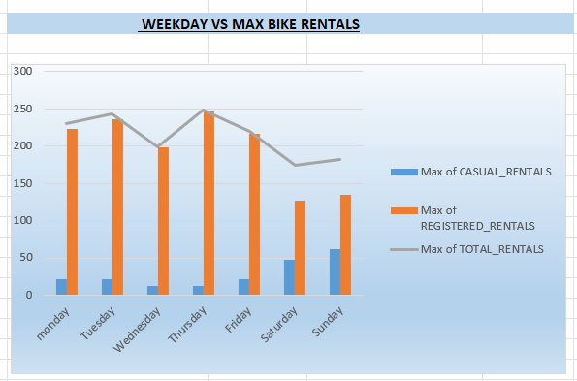
Pivot Chart overview
Charts were prepared illustrating demand for various possible combinations to analyse relations of variation of data based on specific parameters.
Few of these charts is attached.

Slide 8
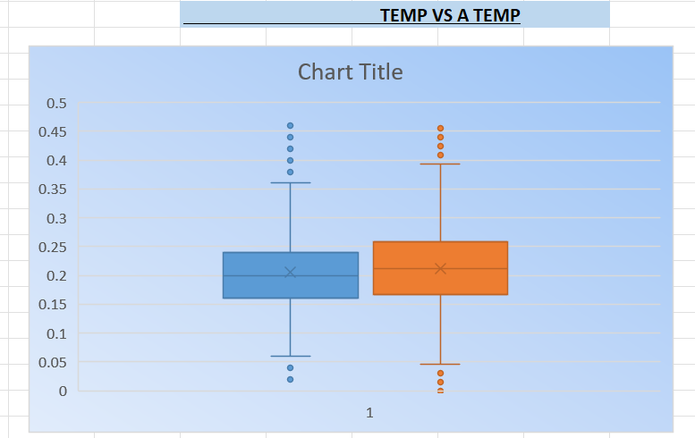
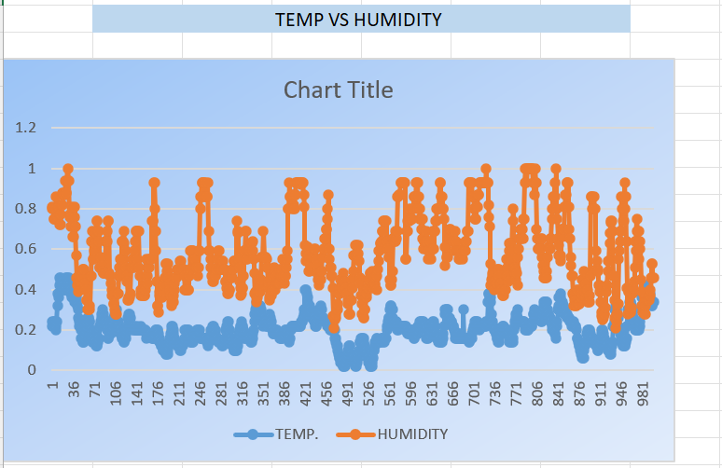
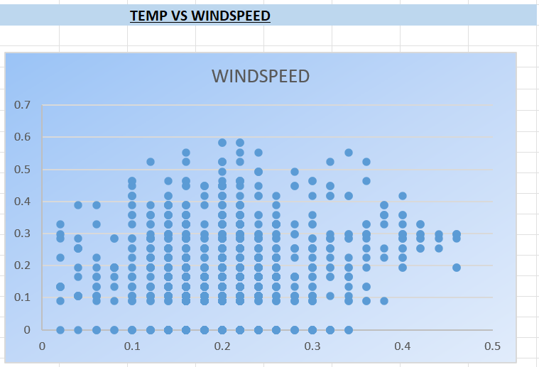
Correlation Chart overview
Correlation analysis charts helps understand how weather conditions influence bike-sharing demand and supports better demand forecasting.

Slide 9
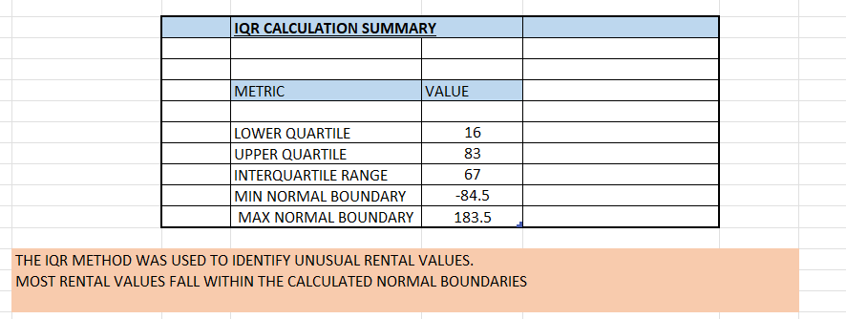
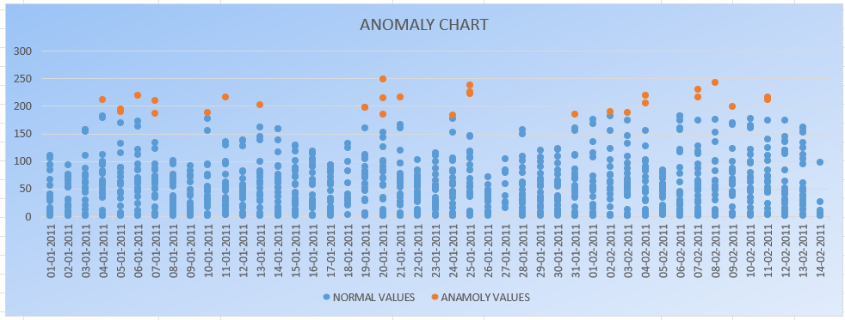
Anomaly Sheet Analysis
Anomaly chart highlights normal rental values in blue and anomalous values in orange.
Most observation fall within normal range.
Few unusual high value indicate potential demand spikes.
5

Slide 10
Forecasting Sheet — What I Have Done
• Kept the date column as the timeline and total rentals as the target series.
• Used Excel's Forecast Sheet output, with forecast and lower/upper confidence-bound columns.
• Placed historical values and predicted values on the same time axis for comparison.
• Used confidence bounds to communicate forecast uncertainty rather than presenting a single value as certain.
• Before presenting, verify that the forecast output has recalculated in Excel and that date ranges are correct.
15

Slide 11
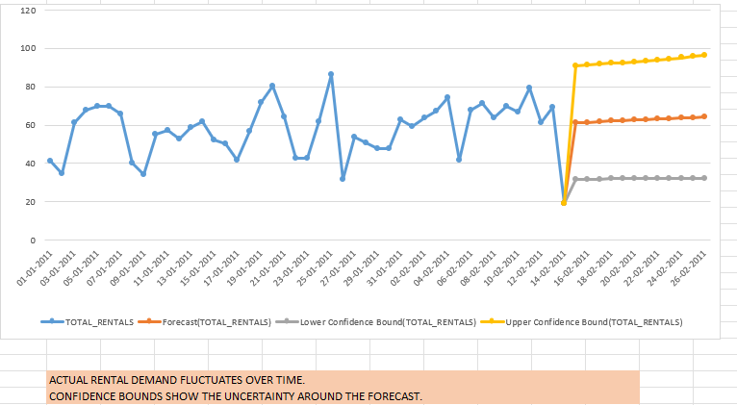
Forecast Sheet Analysis
Forecast sheet studies the historical raw data provided and based on it gives expected forecasting of upcoming days
Forecasted values are given orange colour
5

Slide 12
Dashboard — What I Have Done
• Collected key charts into one dashboard sheet for a consolidated view.
• The worksheet contains eight embedded charts and three embedded images.
• Chart objects include bar, 3-D bar, line and pie charts.
• The dashboard gives a quick visual overview; detailed values should be checked against the pivot tables.
6

Slide 13
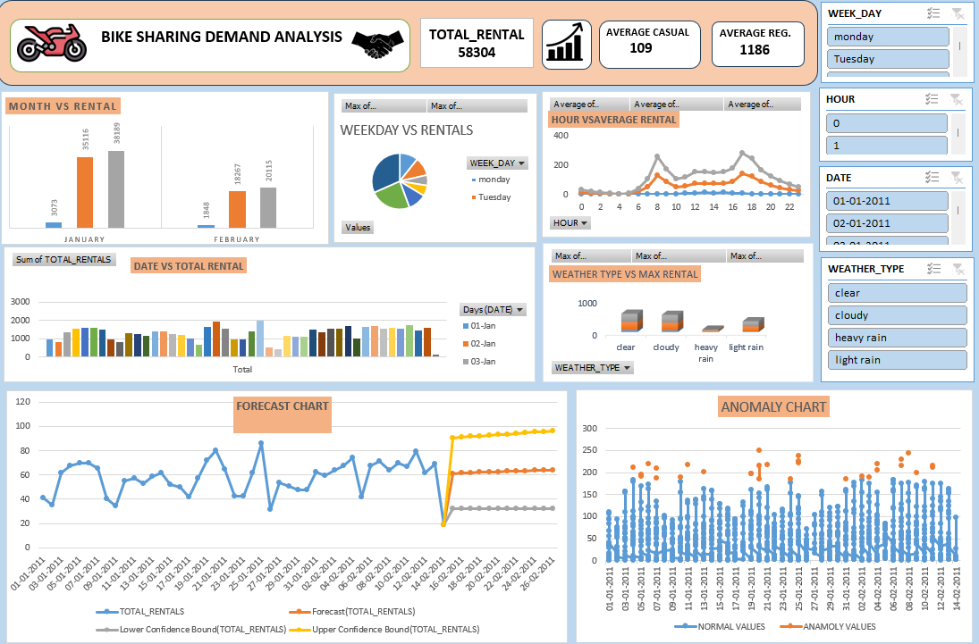
Dashboard Overview
Dashboard gives the user friendly final look to get raw data and summary analysis in one frame
5

Slide 14
Summary & Interpretation
• Rental demand is summarized by multiple time and weather dimensions in the workbook.
• The dashboard combines several charts into one overview.
• Pivot tables reduce raw rows into comparable group-level metrics.
• Correlation and heatmap views show direction and strength of linear relationships, not causation.
• The IQR sheet flags unusually low or high total-rental values for further review.
• The forecast view supports planning but should be compared with actual future data.
18

Slide 15
Strategic Recommendations
Practical actions to improve bike-sharing service performance
Strengthen Rush-Hour Fleet Planning: Position additional bicycles at high-demand stations ahead of commuter peaks, using historical trip data to anticipate morning and evening shortages.
Use Member Trends to Forecast Demand: Review repeat journeys and subscription activity to identify regular travel patterns, then align station capacity and rebalancing schedules with those trends.
Integrate Weather into Daily Decisions: Include rainfall, temperature and wind forecasts in staffing and fleet plans. Adjust bicycle redistribution and customer communications when conditions are likely to affect trips.
Increase Engagement Among Occasional Riders: Create targeted campaigns that encourage infrequent users to ride more often. Potential initiatives include: Off-peak and weekend ride offers, Limited-time seasonal promotions, Rainy-day or clear-weather incentives and Introductory credits for a first trip
Implementation note: Track bicycle availability, trip completion, repeat usage and campaign response each week to identify which actions deliver measurable improvements.
18

Slide 16

18

